Slide 1




Welcome to a partnership in Learning!

Slide 2


At Longmoor Primary school we follow the phonics program Sounds Write.

Slide 3
What is Sounds Write?
Sounds Write is a phonic rich program which focus' on teaching the 3 main skills required to successfully read and write. They are
* segmenting - c/ a / t
* blending
* phoneme manipulation
It is through repetition, exciting learning experiences, daily reading and writing that children in our school flourish as fluent readers and writers.

Slide 4
What does Sounds Write look like in a Reception classroom?
* A daily routine whereby all children explore lessons of word building, sounds swaps, reading and spelling of a focus sound that week for example /s/. We will demonstrate these for you shortly.
* In Reception the children learn all the single sounds and some digraphs for which the children know as 'two letters representing one sound'. For example the /ch/ in chin

Slide 5
Word building
This activity teaches the children to identify sounds in words and how they are built together through the skill of segementing.
We are going to build three words together.
When we teach through word building we encourage the children to use gestures to help segment the sounds in a word.

Slide 6
Same sound different spellings
Let’s have a go!

Slide 7
Sound Swap
Phoneme manipulation the skill of interchanging and swapping of sounds. Children learn sound and symbol correspondence through this activity. This is how a nonsense sound swap would be performed.

Slide 8
Same sound different spellings
Let’s have a go!

Slide 9
Seek the Sound
An activity such as seek the sound is used with an age level appropriate reading text that is full of words using a particular focus sound.
This activity is used once a new sound has been exposed through word building and children are to identify the sound in a range of words

Slide 10
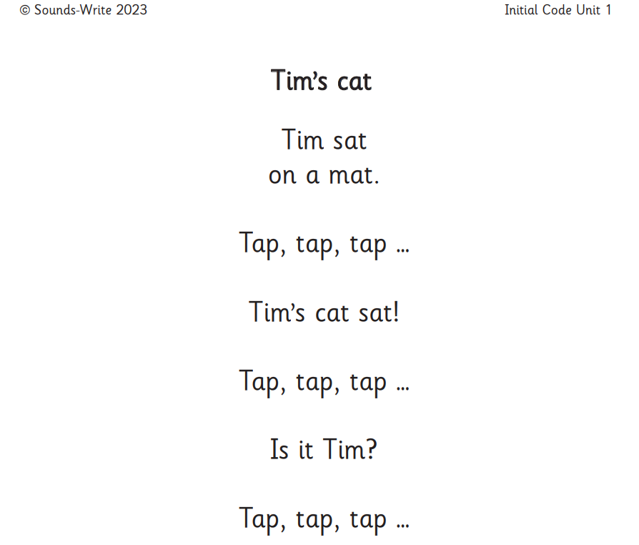

Slide 11

How can you provide extra support your child at home? https://www.youtube.com/watch?v=a8ZMfYjdN-s
When reading with your child its important that we try to encourage children to identify sounds instead of saying it’s the /A/ sound which is not the correct sound for that particular word or the letter e as this only leads to confusion. For example A instead of a
chick > the sounds would be /ch/ /i/ /ck/ not /c/h/i/c/k.
If your ever stuck or unsure of a sound in a word a trick to remember is to cover up the word say the word out loud and think about the sounds you hear!
You are also encouraged to incorporate any of the demonstrated lessons shown into your home learning sessions or if that’s too much turn it into a fun game for example memory.

Slide 12
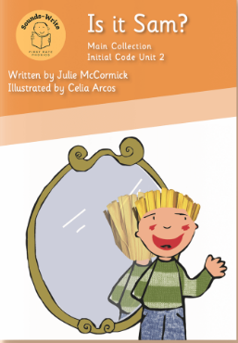

Reading books and Diary
Books every Friday
Same book- BORING/NOT CHALLENGING!
One part of their reading journey
We learn and practise everyday in school and they need the practise at home too (3 x a week at least).
Same book for repeated practice is essential for code knowledge to be embedded into their long term memory. Confidence and Fluency!
In school we are teaching sounds beyond this
We need children to revisit so they can succeed so they can move confidently to the next stage.
They are not everything that children need to read
If you have concerns, talk to the class teacher

Slide 13
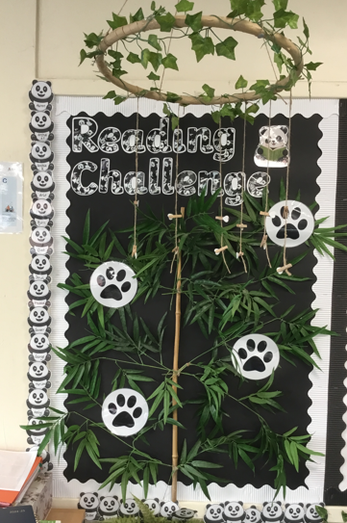
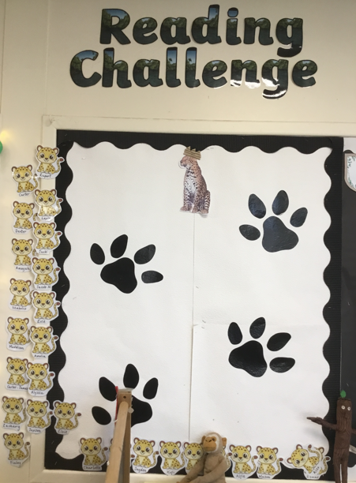

School Reading Challenge
Reading for Pleasure

Slide 14
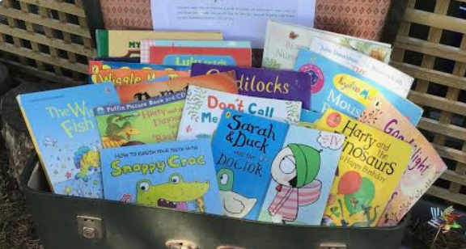
Home Library Service
Every Wednesday at 8.45-9am

